Slide 1

Distance Sensing Robot with Voice Control
Chinmay Galande, Anirudh Arunkumar, Sufiyan Ahmed, Ashwin Kulkarni
ECE 4180 Final Project
Georgia Institute of Technology

Slide 2
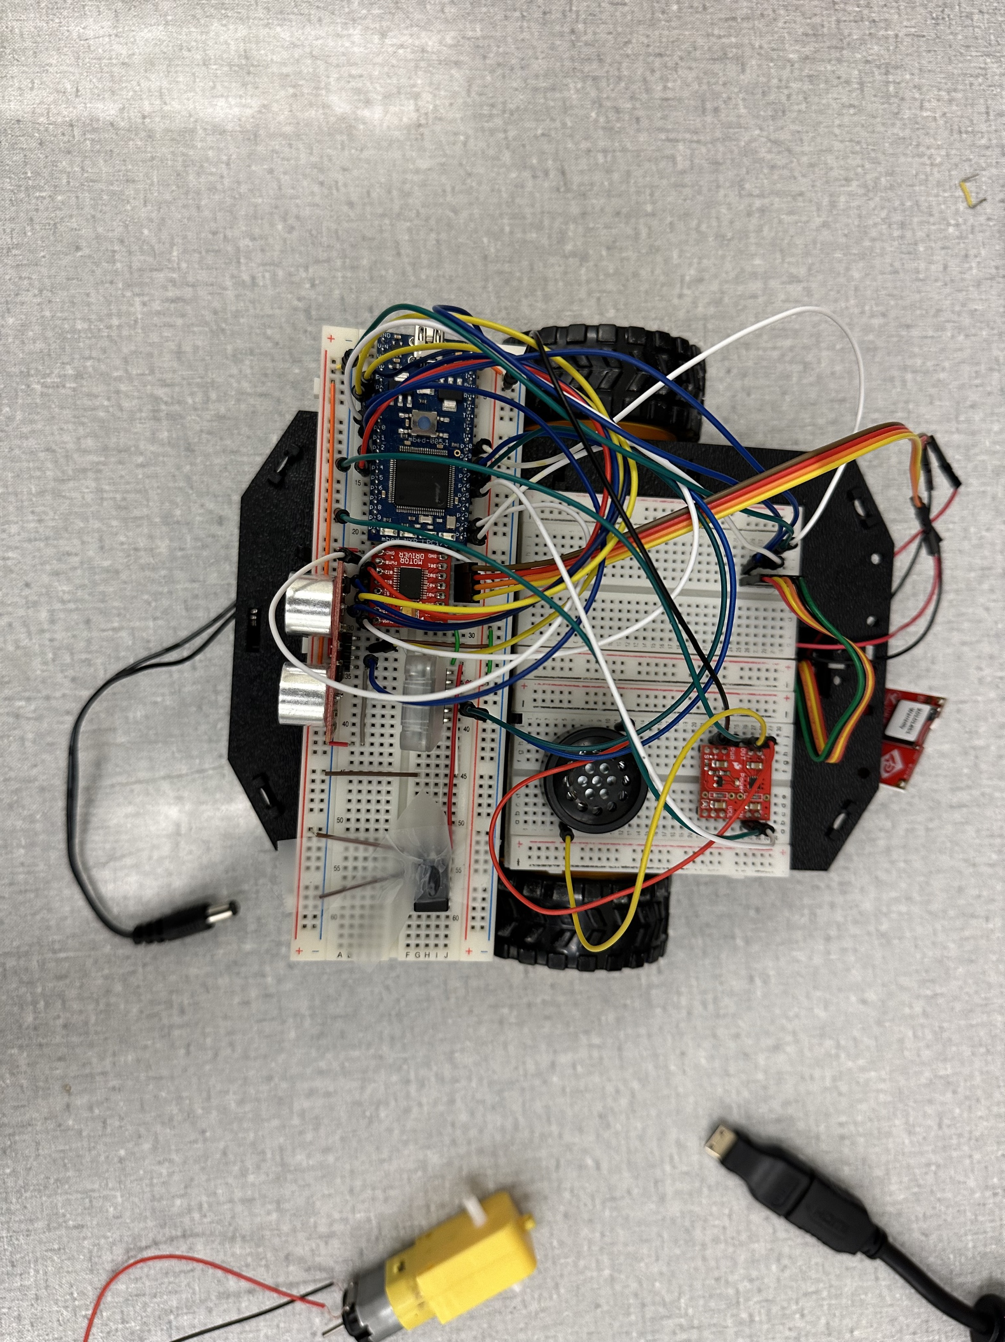
Introduction
Welcome to our presentation on the Voice-Controlled Robot with Obstacle Avoidance. Inspired by the Roomba bot, which uses sensors and cameras to detect its surroundings and navigate them while vacuuming, our project aims to design a robot that can autonomously navigate its surroundings and avoid obstacles, while also being manually controlled using voice commands. To achieve this, we have developed a robot that can be controlled using an app built on the MIT App Inventor platform.
In this project, we will be discussing the design and implementation of the Voice-Controlled Robot with Obstacle Avoidance, its features, and its potential applications. We will also highlight the challenges we faced during the development process and the solutions we adopted to overcome them. Finally, we will demonstrate the capabilities of the robot in action through a live demonstration.

Slide 3
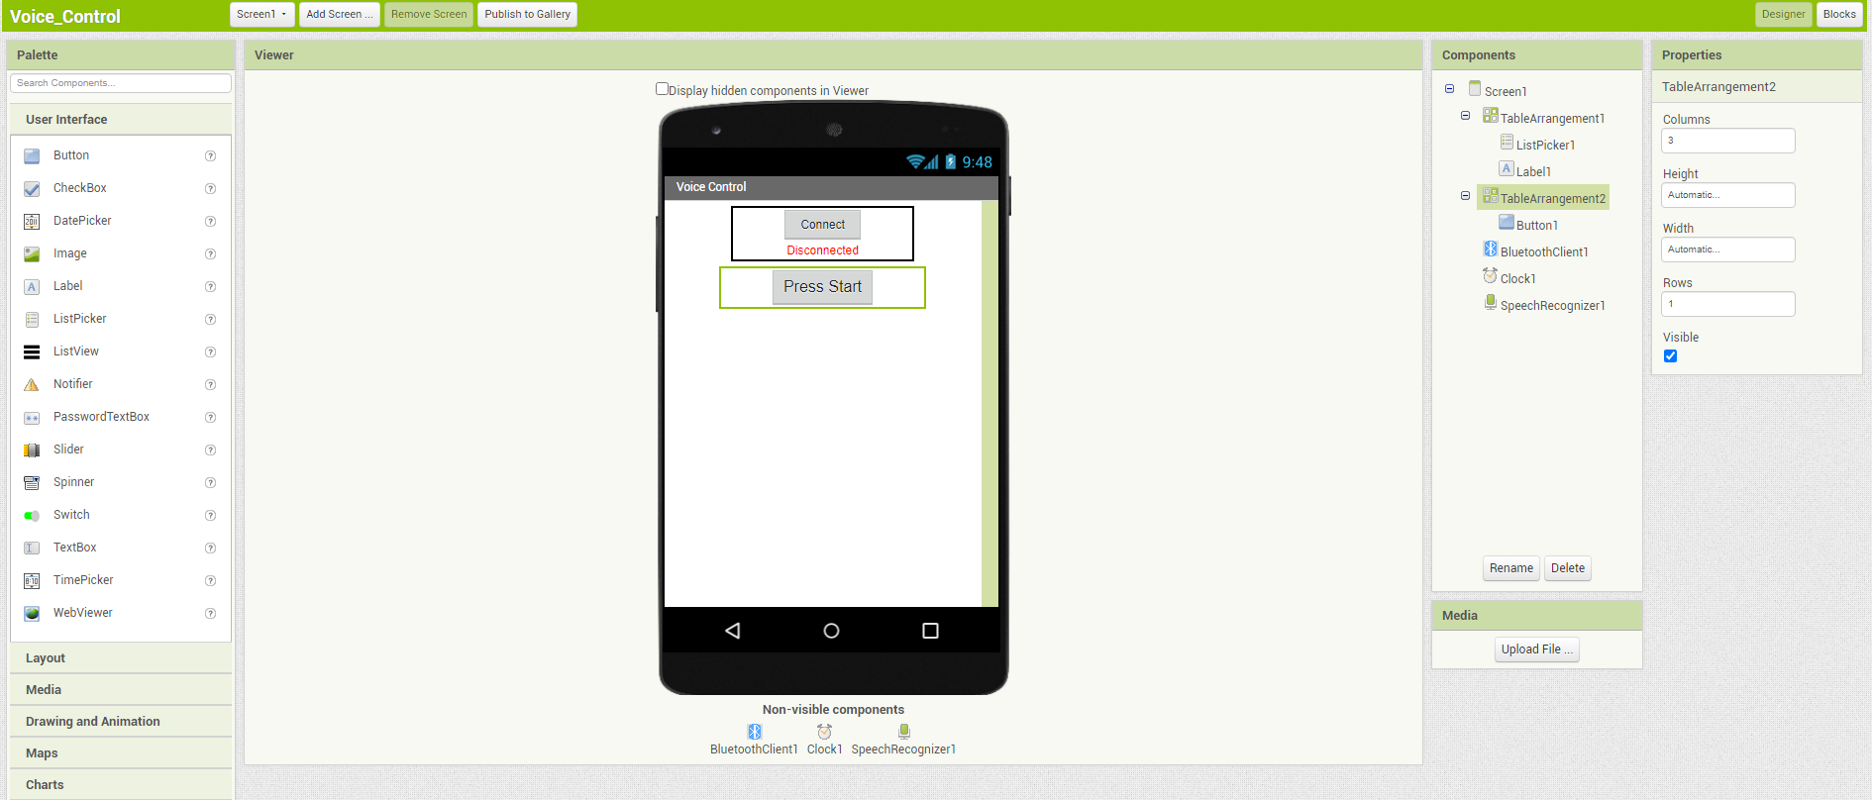
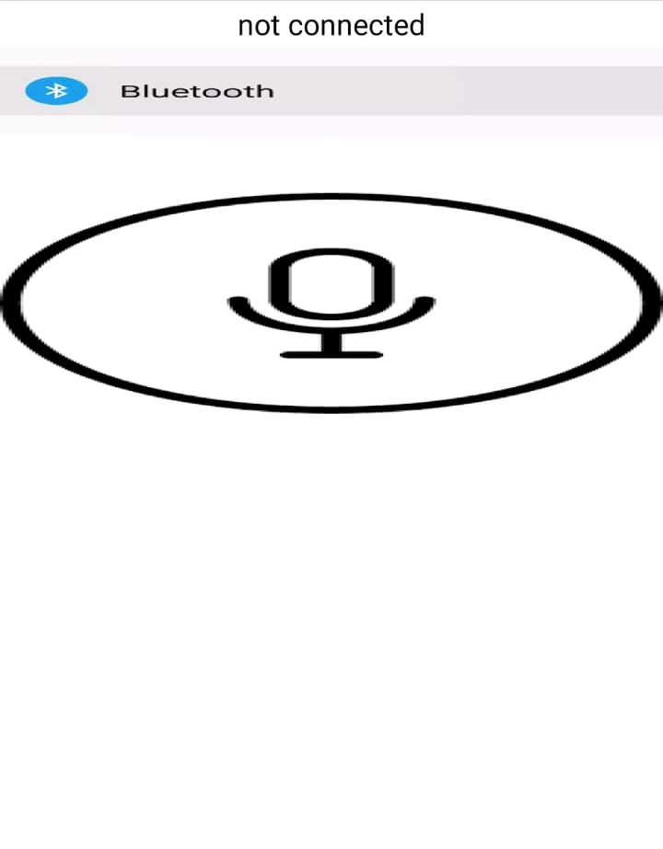
Functionality
Autonomous mode (Say “Auto”)
Distance read via the ultrasonic sensor on the front
If an obstacle is detected within ~25cm, it will stop, back up a bit, and turn either left or right randomly, and move on
Speaker “beeps” when moving backwards
LCD shows that it is in Autonomous mode
Voice mode (Say “Bluetooth”)
Drive forward, backward, stop, and turn via voice commands
LCD shows the bluetooth mode
Speaker “beeps” when moving backwards

Slide 4
Parts List
Mbed LPC1768: https://www.sparkfun.com/products/9564
HC05 Bluetooth Module: https://a.co/d/0m9C4Wu
Jumper Wires: https://www.sparkfun.com/products/124,
https://www.sparkfun.com/products/11026, https://www.sparkfun.com/products/12794
Ultrasonic Sensor (HC-SR04): https://www.digikey.com/en/products/detail/osepp-electronics-ltd/HC-SR04/11198533
H-Bridge (SparkFun Motor Driver): https://www.sparkfun.com/products/14450
uLCD-144-G2 128: https://www.sparkfun.com/products/11377
Speaker: https://www.sparkfun.com/products/11089
DC Motor (DG01D) x2: https://www.sparkfun.com/products/13302
Rubber Wheels x2: https://www.sparkfun.com/products/13259
Shadow Chassis: https://www.sparkfun.com/products/13301
AAA Batteries x4: https://a.co/d/3kETYpp

Slide 5
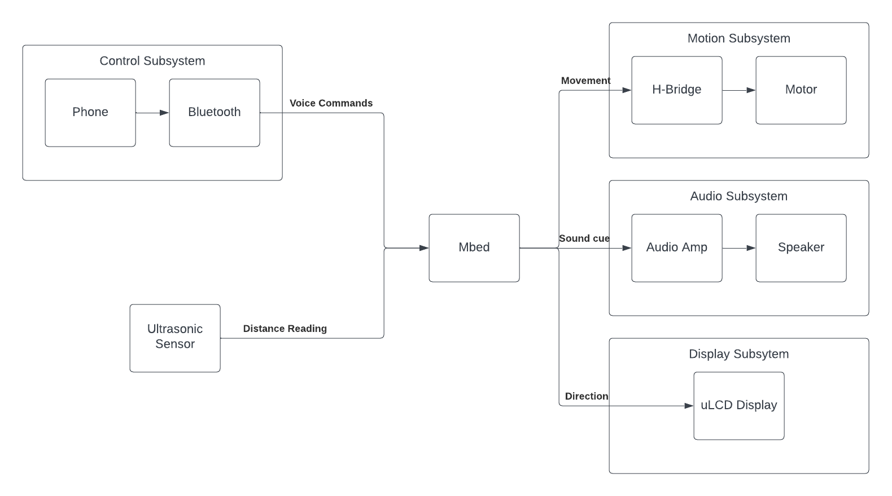
Block Diagram

Slide 6
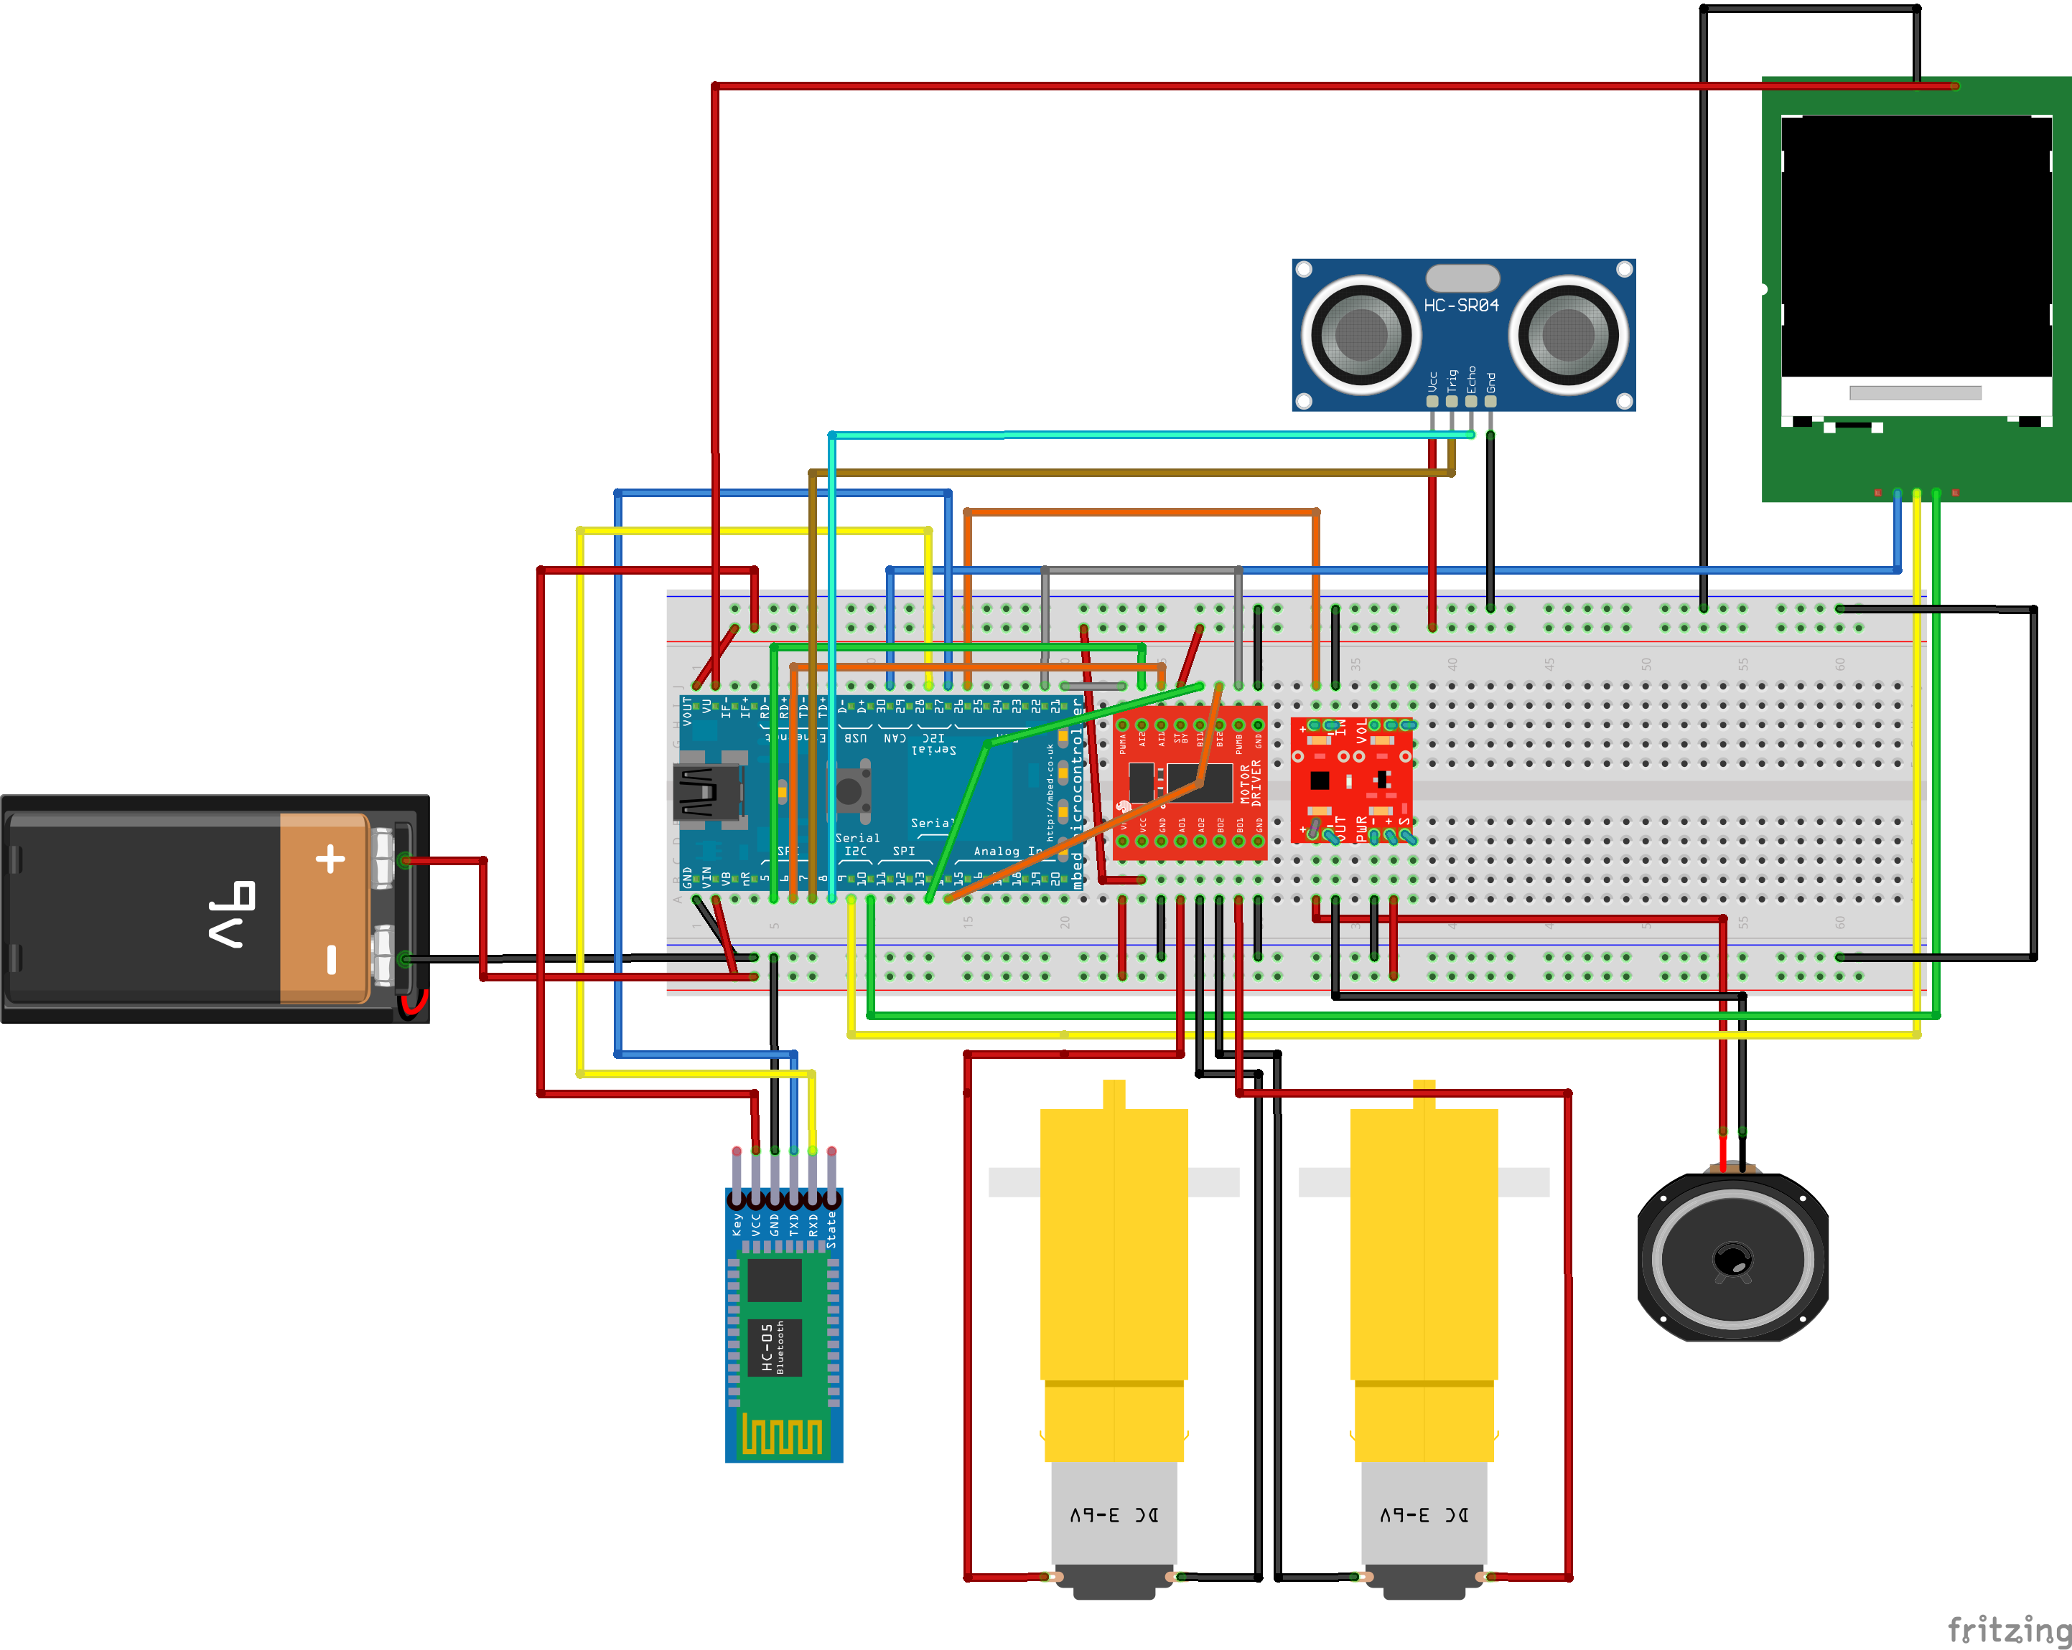
Schematic

Slide 7
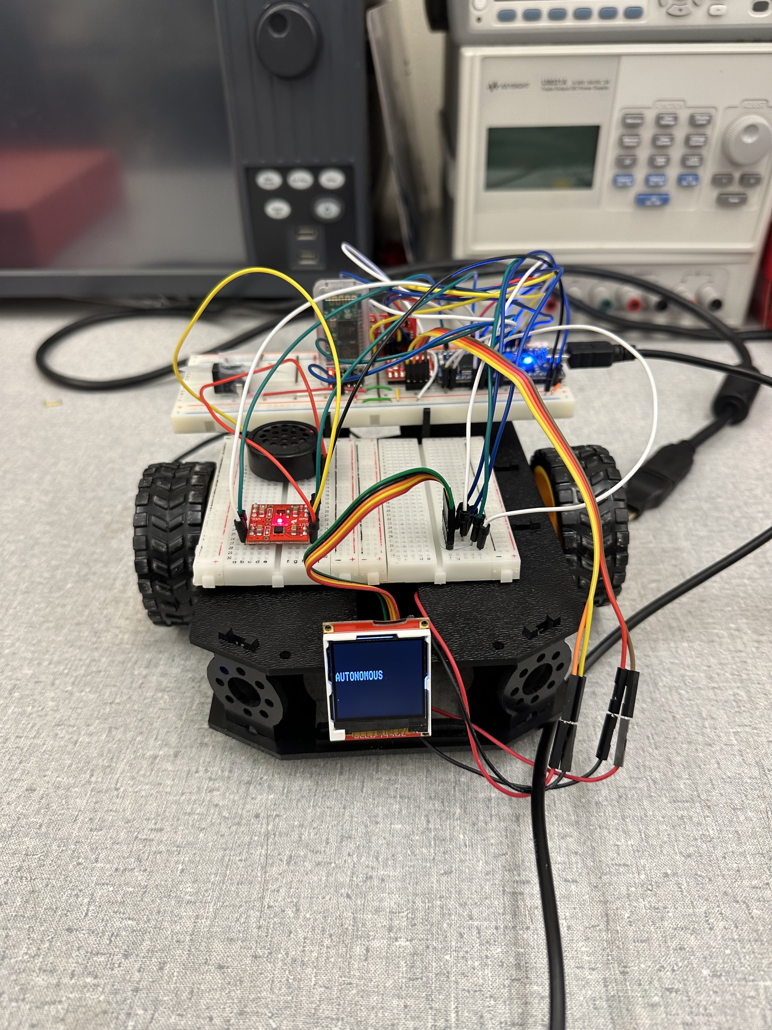
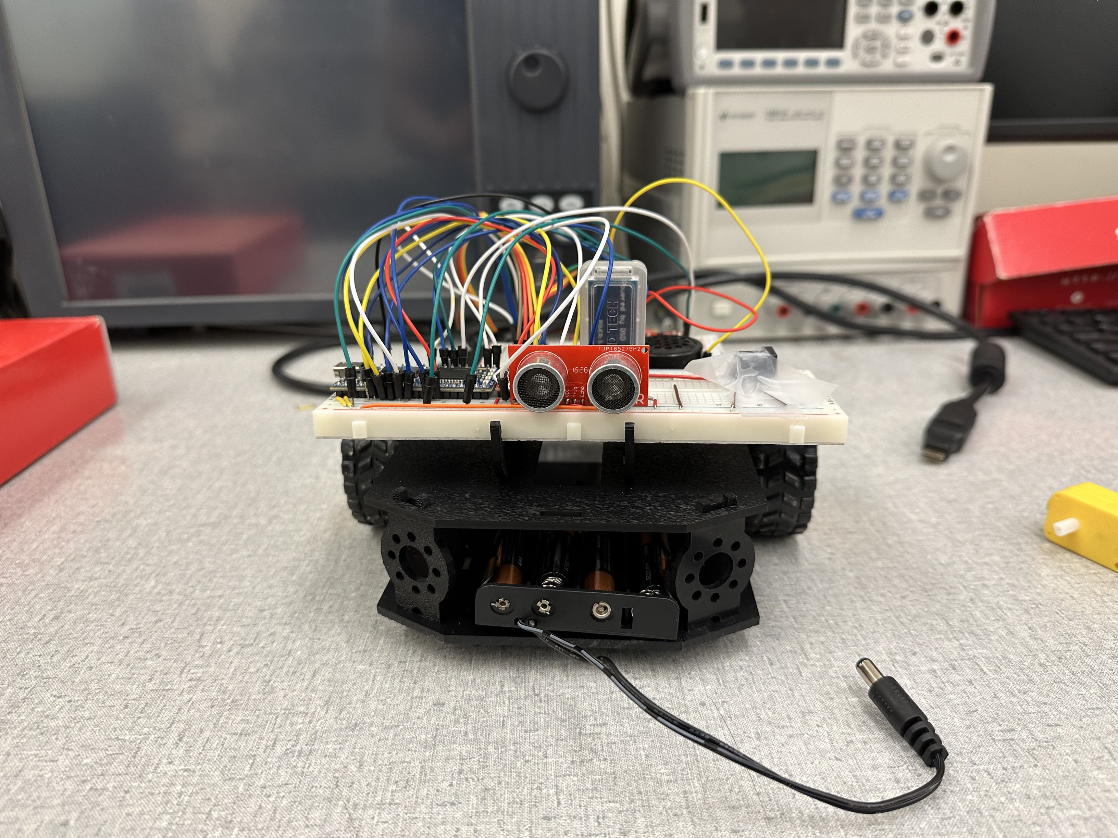
Picture of the Robot

Slide 8
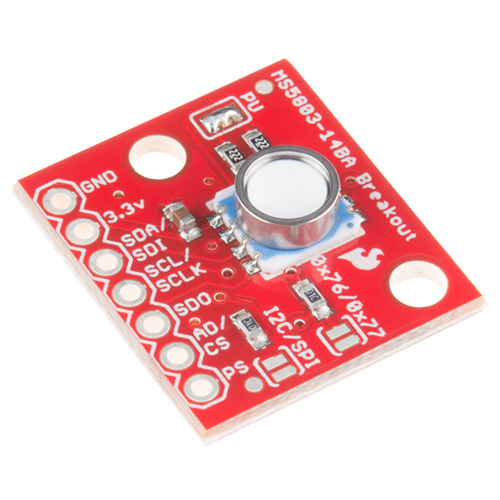
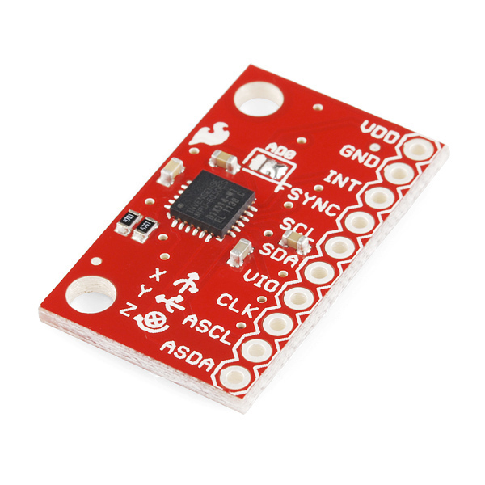
Conclusion & Future Direction

